Slide 1


Analytics AcceleratorTM Certification
Learn Analytics directly from Corporate Pros and Experts
Text Mining Using R

Slide 2

Contents
Text Mining – An Introduction
Introduction
What is Text Mining
Types of Text Mining
Approach to Text Mining
Detailing Approach
Data Collection – Twitter Example
From Unstructured to Structured
Advance Visuals & Analysis
What Else ?

Slide 3
Statistics Introduction
Introduction
What is Text Mining
“Text Mining is the process of deriving high quality information from text“
Applications
Document Summarization
Text Categorization
Concept/Entity Recognition
Sentiment Analysis
Type of Text Mining
Bag of Words
Semantic Parsing
Approach to Text Mining
Define Problem Statement
Blogs
Blogs
Data Collection
(Unstructured Data)
Data Collection
(Unstructured Data)
Reviews
Reviews
Twitter
Twitter
Convert to Structured Data
Analyse & Results

Slide 4
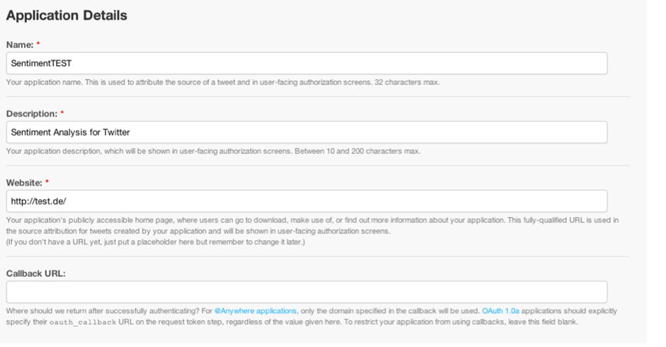
Statistics Introduction
Data Collection – Twitter Example
How to Access Twitter Data ?
Create a twitter account if you don’t have any Click Here
Login with your twitter account on https://apps.twitter.com/
Click on Create New App
Enter application details in the form appearing on the screen (screen shot pasted for Reference)
Click on Create and you will be re-directed to OAuth settings
Copy the following 4 parameters and keep them handy:
Consumer Key <- "YOUR API KEY“
Consumer secret <- "YOUR API SECRET“
Access token <- "YOUR ACCESS TOKEN“
Access token secret <- "YOUR ACCESS TOKEN SECRET“
Fetch the Tweets which are of interest
Where Else ?
Similar APIs are provided by other websites to fetch data, reviews, news articles etc.
A Few of the most commonly used ones are:
Amazon
Flipkart
Google News
Mouthshut
…….

Slide 5
Statistics Introduction
From Unstructured to Structured
Getting the right format
Text mining can only be done on a specific R format called Corpus
Corpus is a collection of documents which in R is also a format for files.
From Data Frame/ Vector to Corpus
R provides a TM Package (Text Mining) to help us do this conversion
Each Text in Data Frame/ Vector to be converted to Document using VectorSource/ DataframeSource
Convert VectorSource/ DataframeSource to Corpus using Vcorpus command
Cleaning Text
TM_Map function from TM Library
tolower()
removePunctuation()
removeNumbers()
Stripwhitespace()
removeWords
Stopwords(‘en’)
stemDocument()
stemCompletion()
Qdap Library
bracketX()
replace_number()
replace_abbreviation()
replace_contraction()
replace_symbol()
TDM & DTM
Remove Sparse Terms

Slide 6
Appendix
References
www.Wikipedia.org
www.datacamp.com

